Slide 1
Open science and multiple hypothesis testing
Class 18
EDUC 157: Educational Research and Evaluation
UCI School of Education

Slide 2
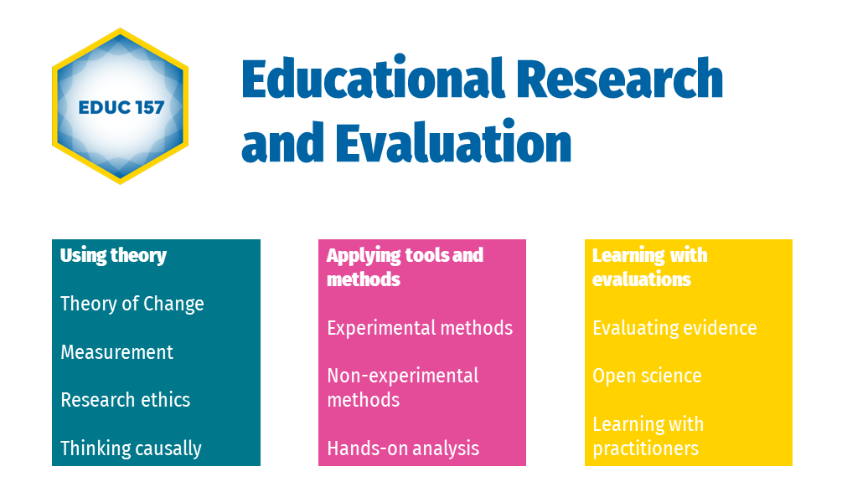

Slide 3
Plan for today
Research in crisis
Multiple hypothesis testing
(Open) science, credibility revolution

Slide 4
Research in crisis

Slide 5
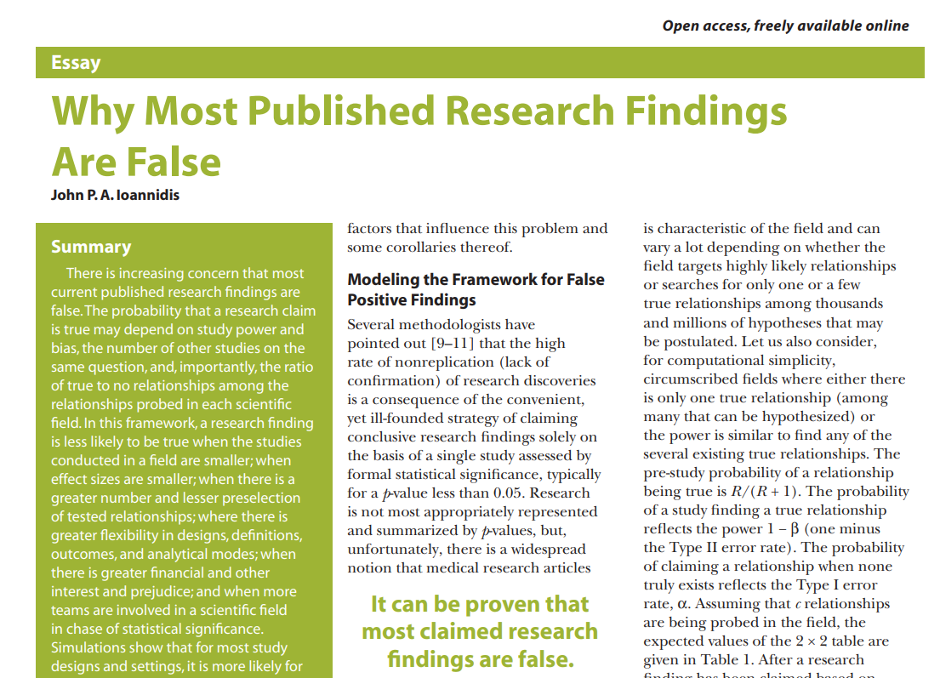
The replication crisis
Notes:
Open Science Collaboration 2015 sought to replicate 100 papers from top psych journals. Mean effect of replications was half that of originals
Medical studies funded by for profit sources more likely to have +ve effects than nonprofit research

Slide 6
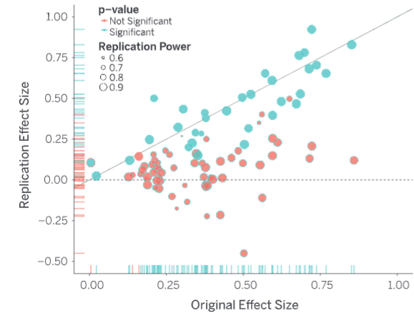
The replication crisis in psychology
Open Science Collaboration, 2015
Notes:
Open Science Collaboration 2015 sought to replicate 100 papers from top psych journals. Mean effect of replications was half that of originals
Medical studies funded by for profit sources more likely to have +ve effects than nonprofit research

Slide 7
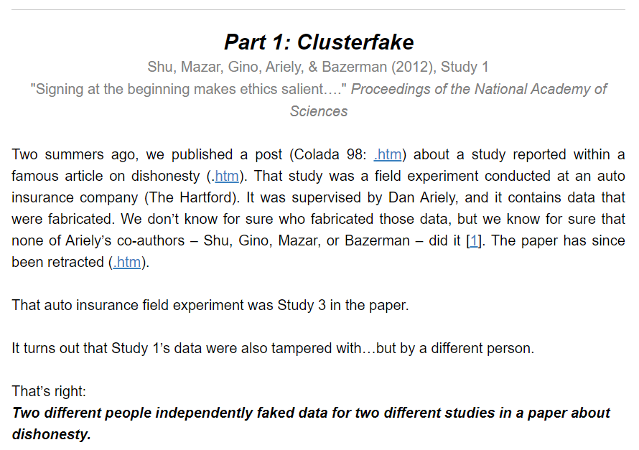
(99.99% likely) fraud in psychology
Notes:
https://datacolada.org/109

Slide 8
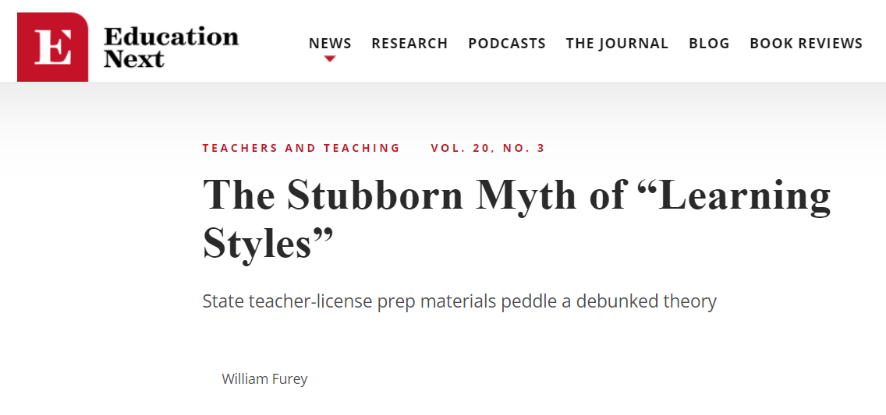
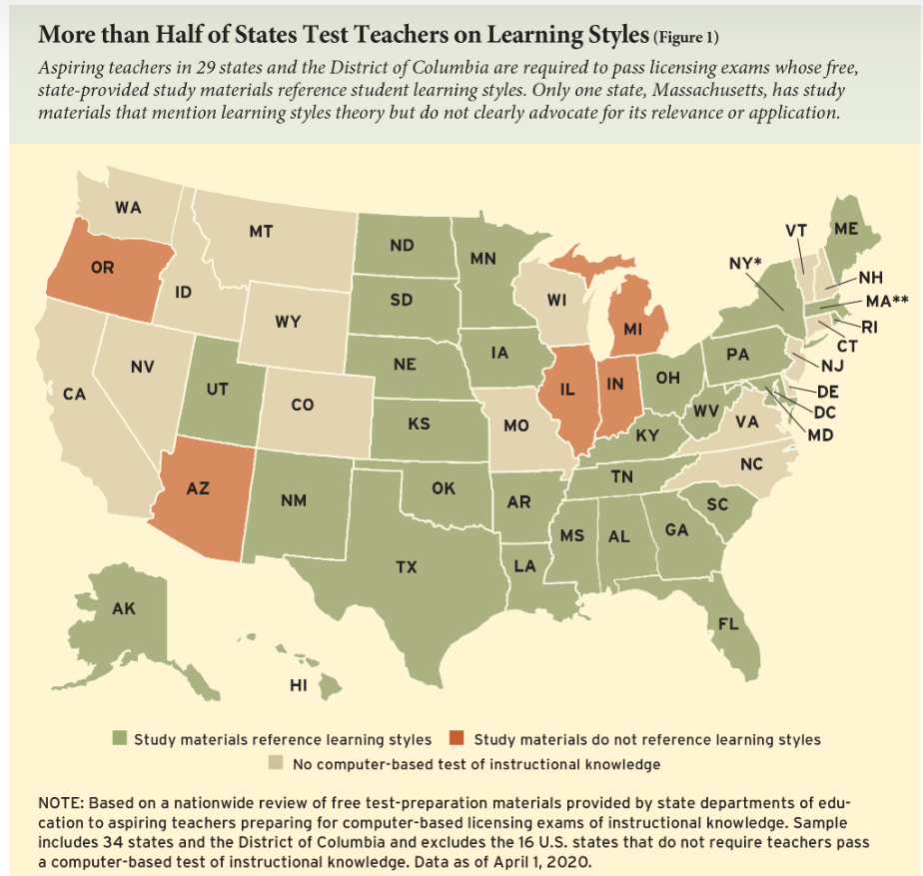
Sticky junk science in education
Notes:
https://www.educationnext.org/stubborn-myth-learning-styles-state-teacher-license-prep-materials-debunked-theory/

Slide 9
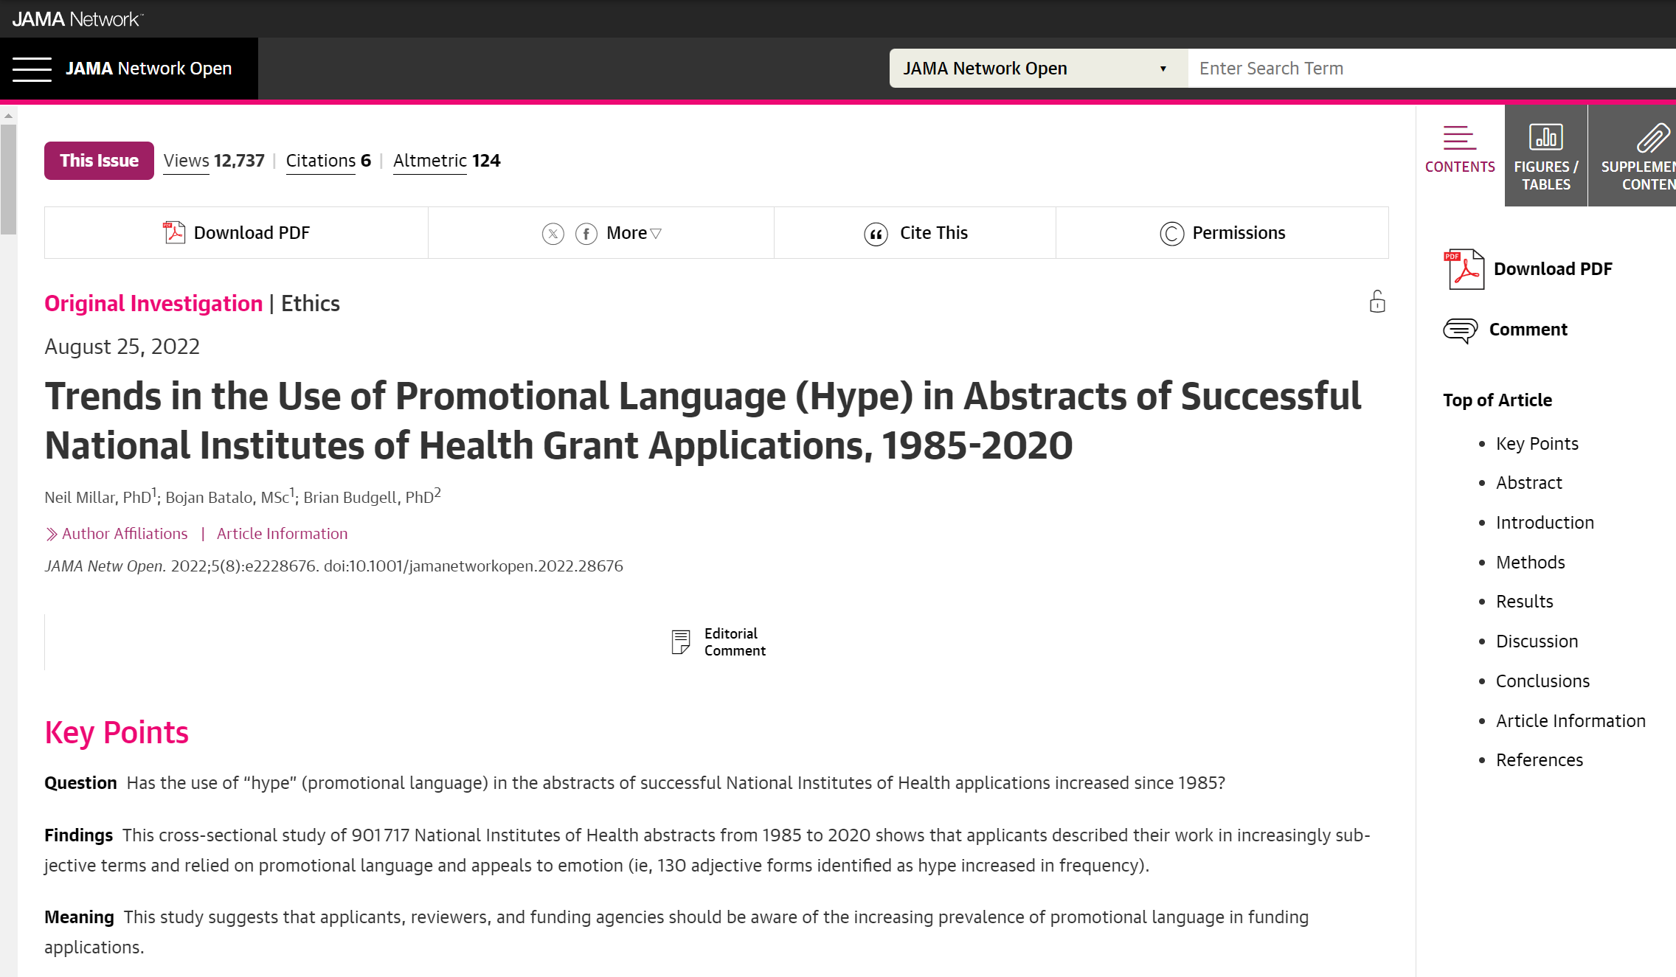
The hype hype is real
Millar et al. 2022

Slide 10
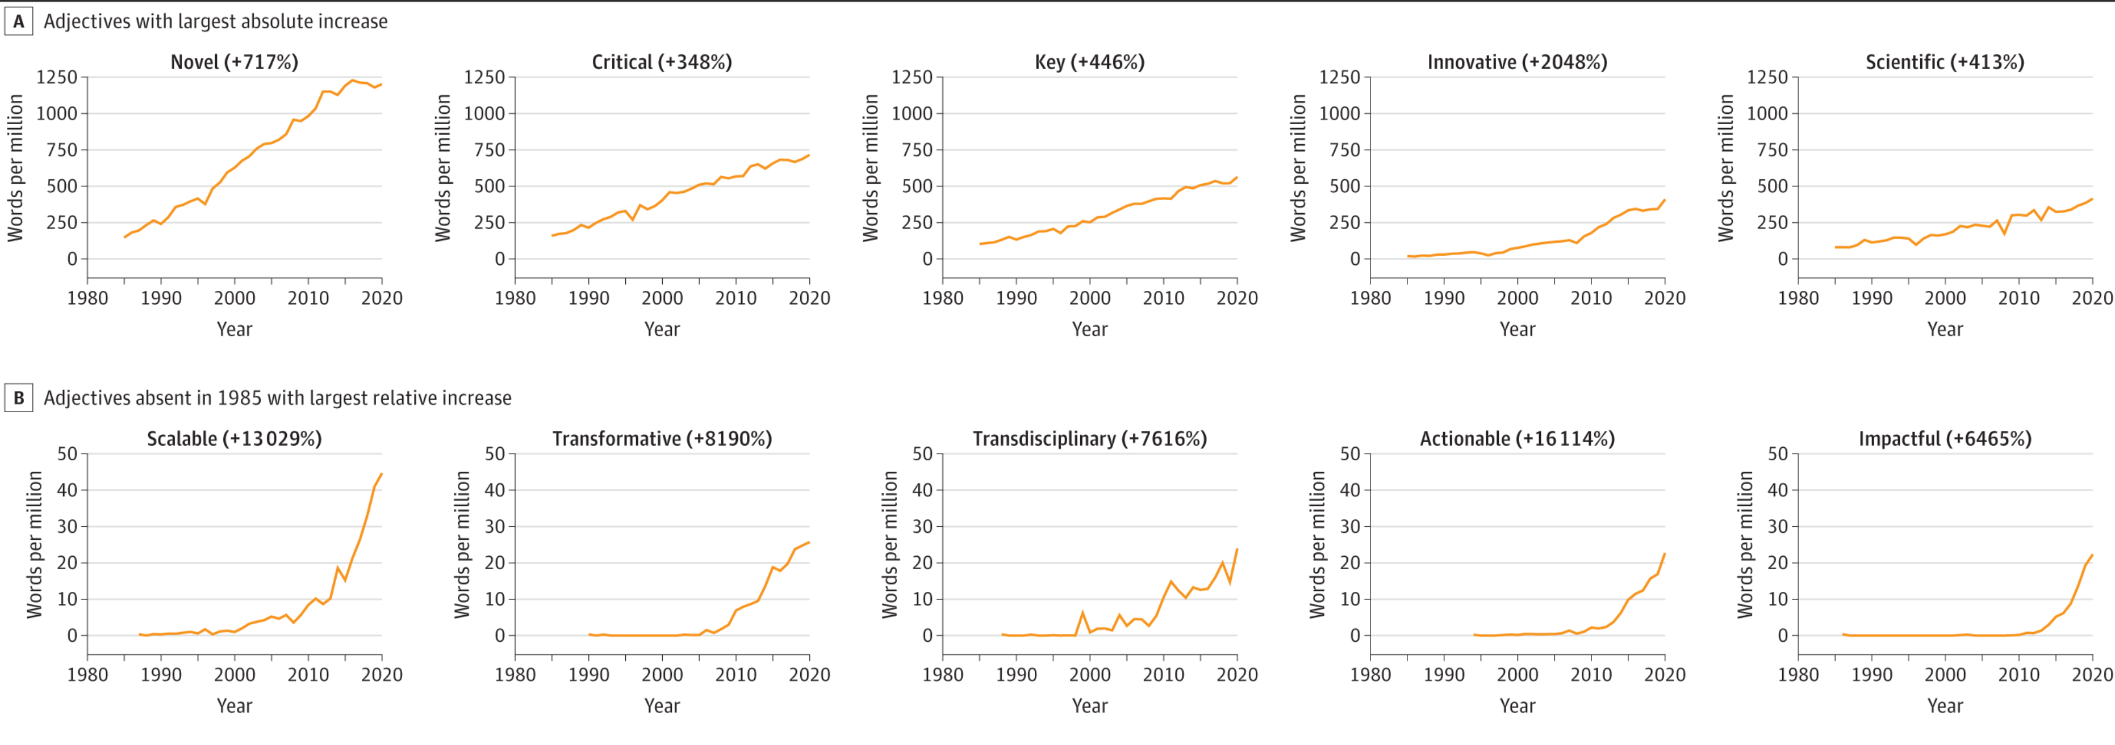
The hype hype is real
Millar et al. 2022

Slide 11
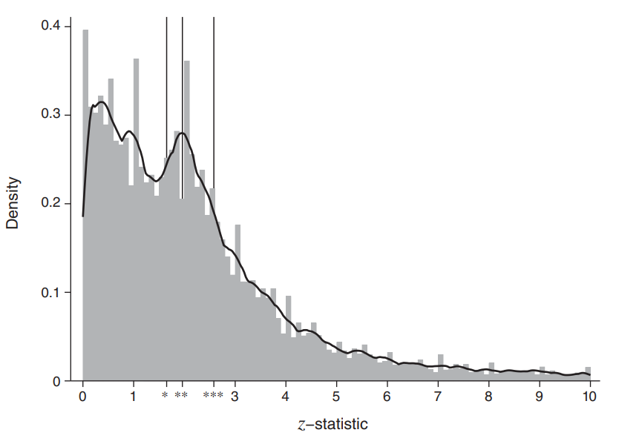
p-hacking, publication bias in economics
Brodeur et al. 2020

Slide 12
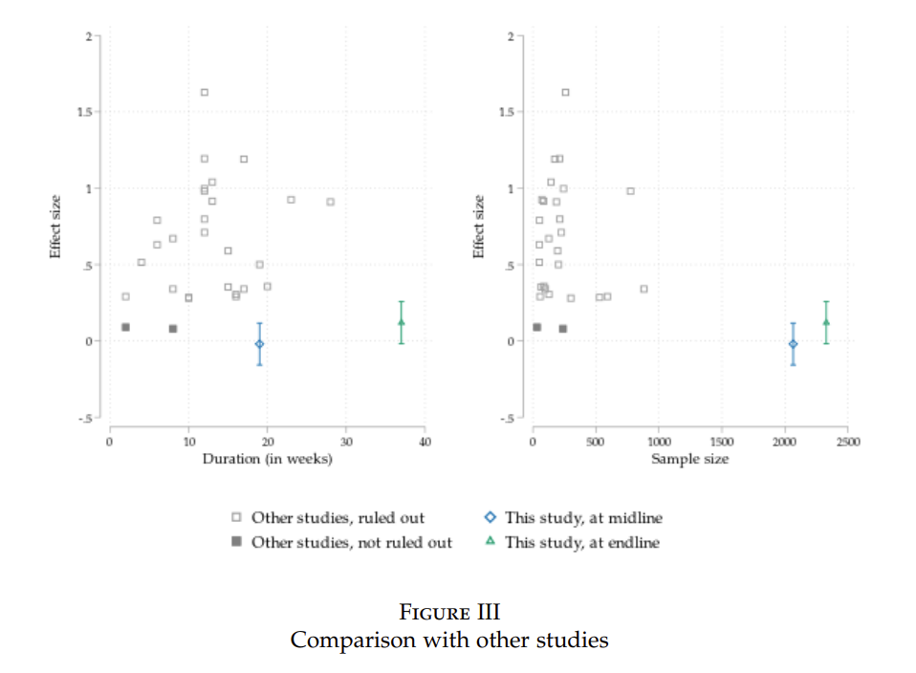
Underpowered studies publish big effects
Notes:
Andreas de Barros, Johanna Fajardo-Gonzalez, Paul Glewwe, Ashwini Sankar, The Limitations of Activity-Based Instruction to Improve the Productivity of Schooling, The Economic Journal, 2023;, uead099, https://doi.org/10.1093/ej/uead099

Slide 13
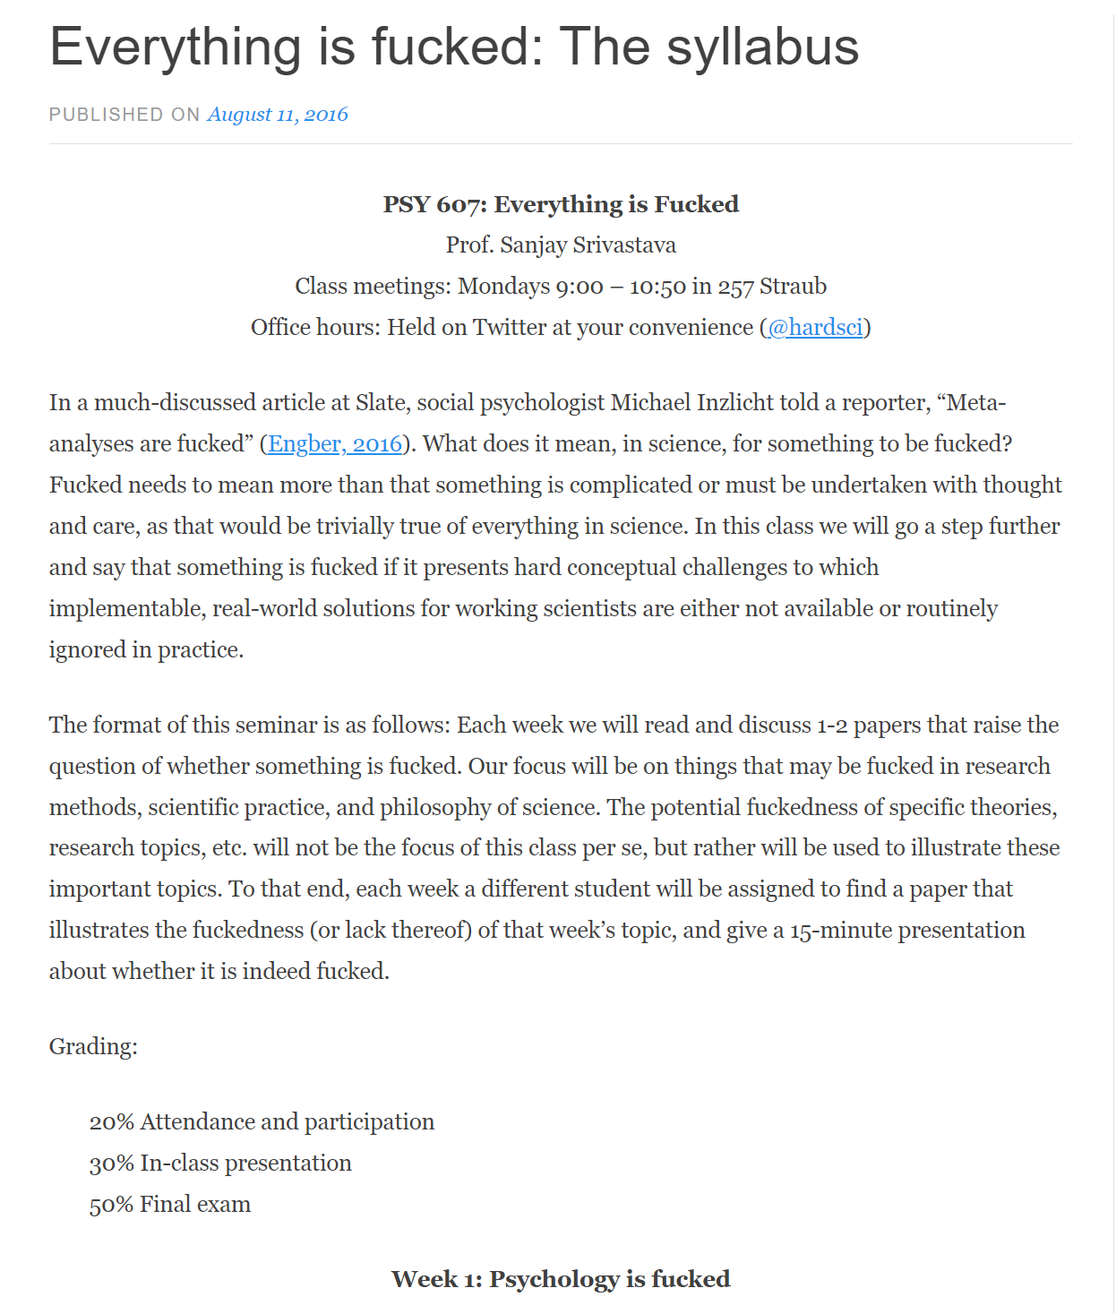
One way to look at it
Notes:
Open Science Collaboration 2015 sought to replicate 100 papers from top psych journals. Mean effect of replications was half that of originals
Medical studies funded by for profit sources more likely to have +ve effects than nonprofit research

Slide 14
A few explanations (not excuses)
Publish or perish, incentives for fishing, p-hacking
Beliefs, preferences, push for “anything goes”
Small-sample, under-powered studies
Novelty counts, hype gets rewarded
No incentives for good practices
“Researcher degrees of freedom”

Slide 15
Multiple hypothesis testing

Slide 16
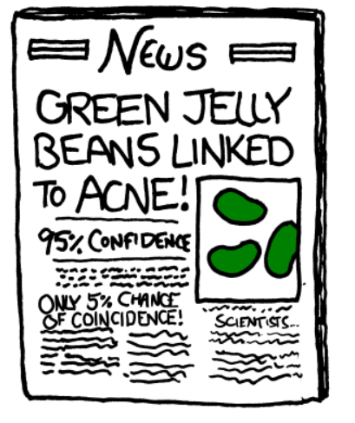
Notes:
https://xkcd.com/882/

Slide 17
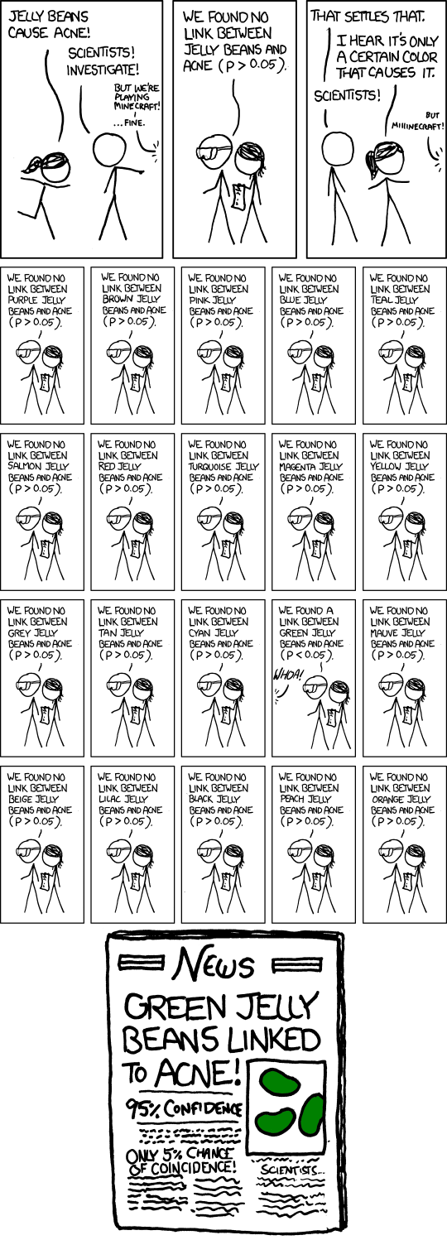

Slide 18
Review of “statistical significance”
Alpha = 0.05 Even if there is no effect, we may falsely conclude that there is one in 5% of the studies (1 out of 20). That’s fine.

Slide 19
Jelly beans in education research
“This program is effective for low-performing girls”

Slide 20
Jelly beans in education research
“In urban schools, this program is effective”

Slide 21
Jelly beans in education research
“This program improved students’ geometry skills.”

Slide 22
Solutions
Use an outcome index
Control the false discovery rate
Control the family-wise error rate

Slide 23
FDR vs. FWER
FDER (False Discovery Rate control) is like checking how many mistakes you make among the toys you pick to play with. For example, if you have many toys and you want to find all the red ones, FDER helps you make sure you don't say something is red when it's actually not.
FWER (Family-Wise Error Rate control) is a bit stricter. It's like making sure you don't make any mistakes at all while picking toys. So, if you're super careful about only saying a toy is red when you're absolutely sure, that's like FWER.

Slide 24
FDR: The Benjamini-Hochberg procedure
Sort the p-values obtained from multiple tests in ascending order.
Compare each individual p-value against a threshold that depends on the desired FDR level (q-value). This threshold gets stricter as you move down the list of sorted p-values.
Identify the largest p-value where the p-value is less than or equal to a certain critical value (determined by the FDR level).
Reject all the null hypotheses corresponding to the p-values meeting this criterion and those smaller.

Slide 25
FWER: The Bonferroni method
alpha* = alpha / number of tests

Slide 26
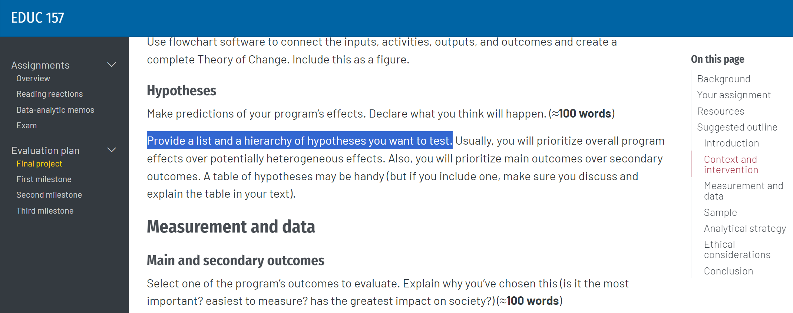
What does this mean for your final project?

Slide 27
(Open) science, credibility revolution

Slide 28
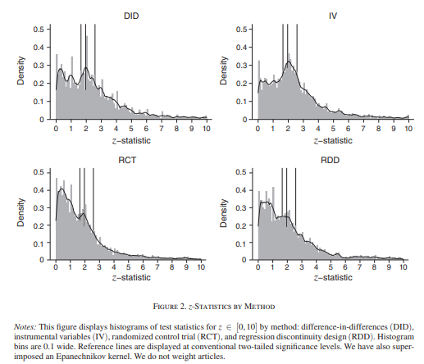
p-hacking is less common in RCTs…
Brodeur et al. 2020

Slide 29
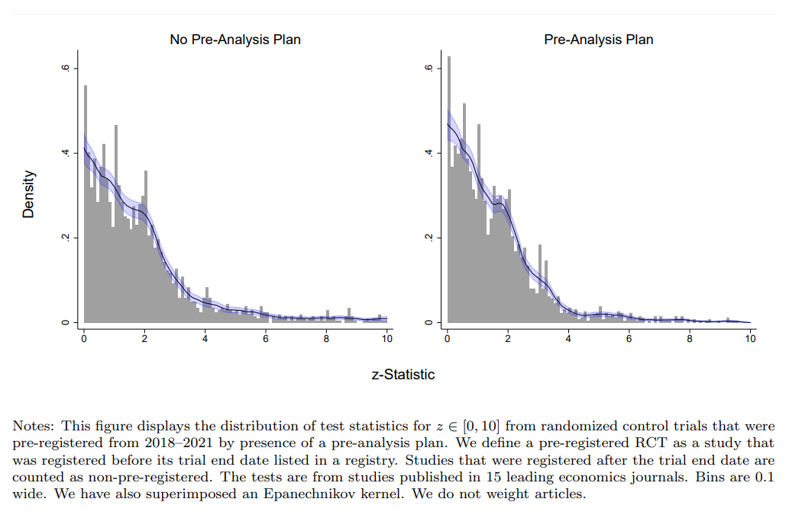
…and less common with pre-analysis plans
Brodeur et al. 2023
Notes:
https://docs.iza.org/dp15476.pdf

Slide 30
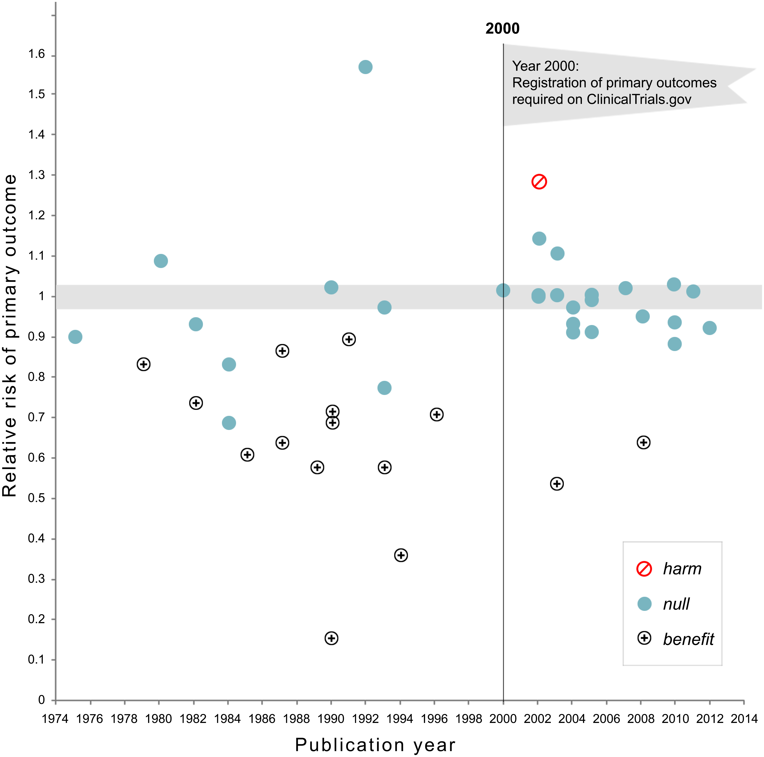
Medicine shows mandatory registration helps
Kaplan & Irvin 2015
Notes:
https://journals.plos.org/plosone/article?id=10.1371/journal.pone.0132382#

Slide 31

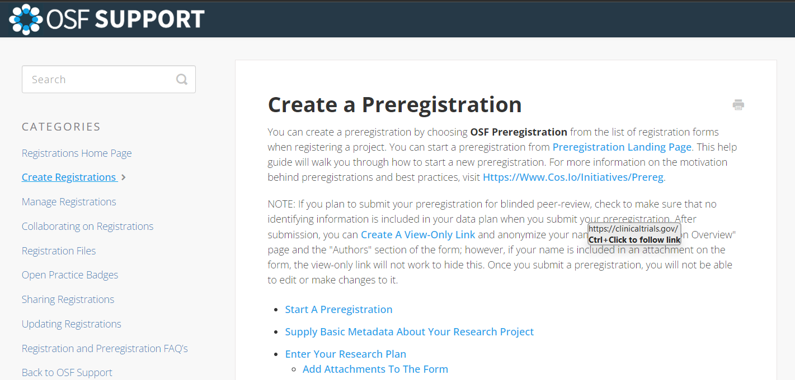
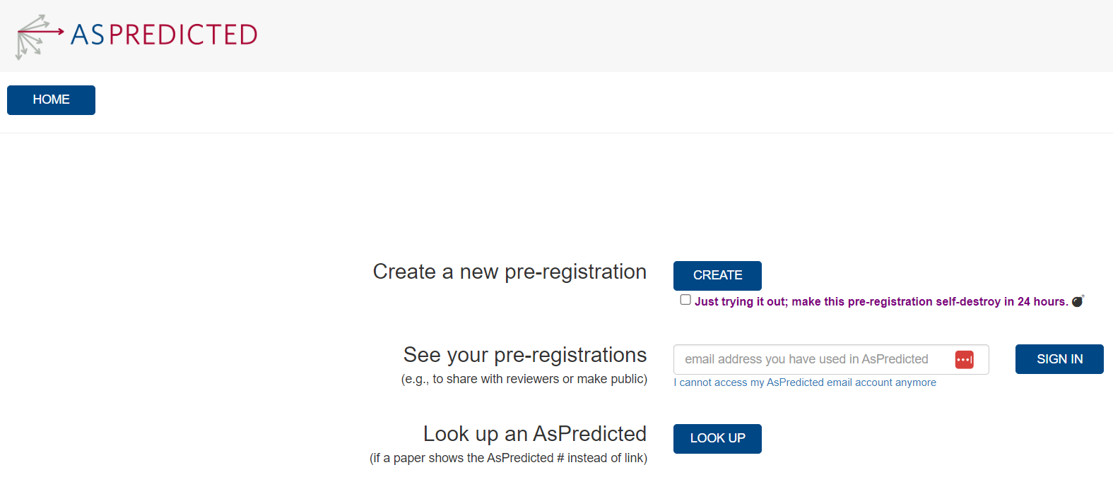
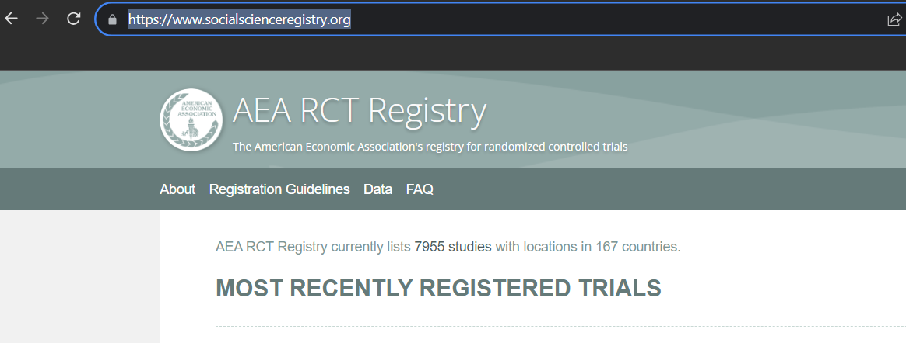
So, register your study …
Notes:
https://docs.iza.org/dp15476.pdf

Slide 32
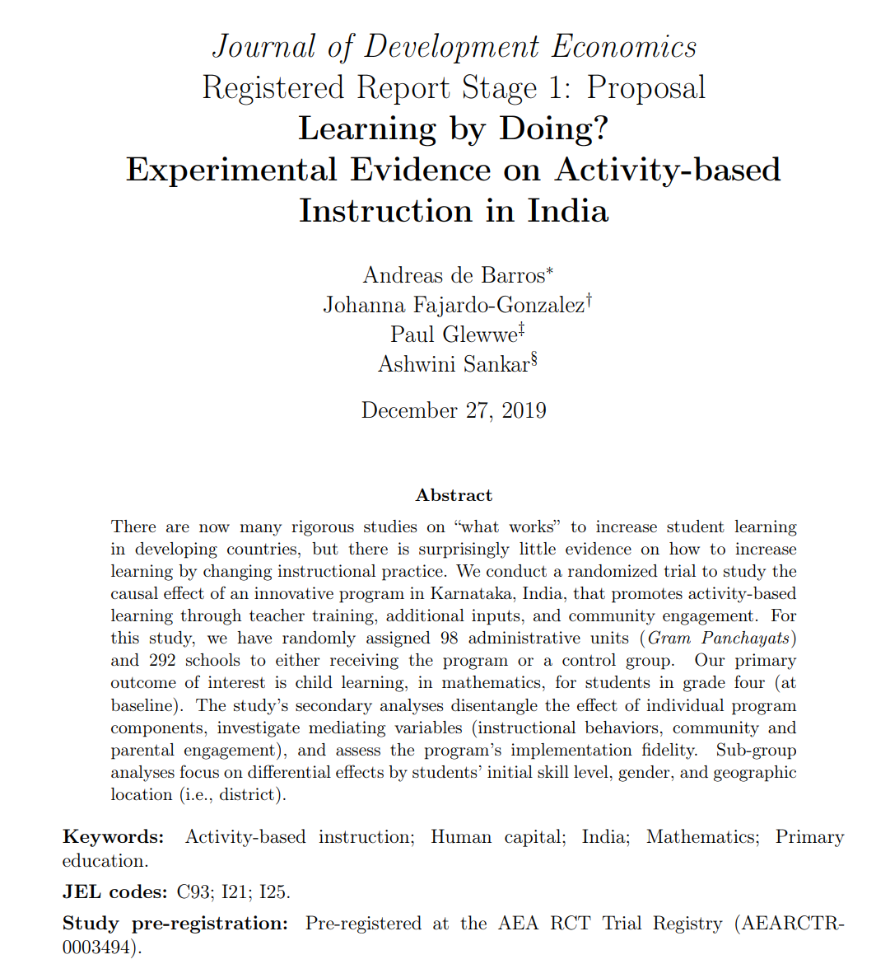
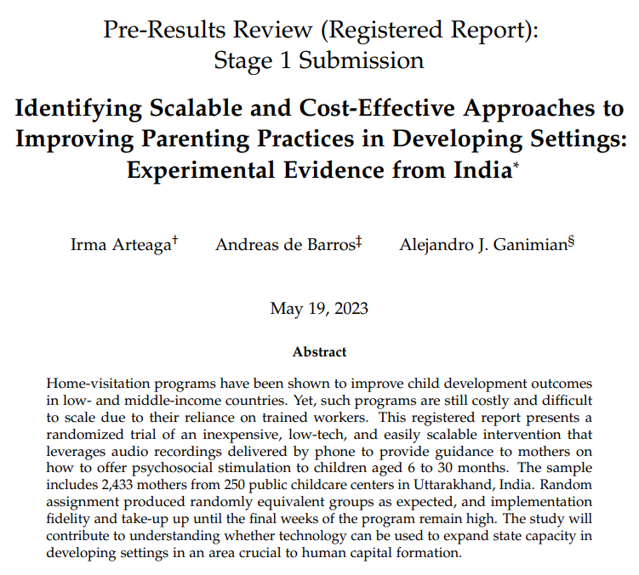
… with a registered report / pre-analysis plan
Notes:
https://docs.iza.org/dp15476.pdf

Slide 33
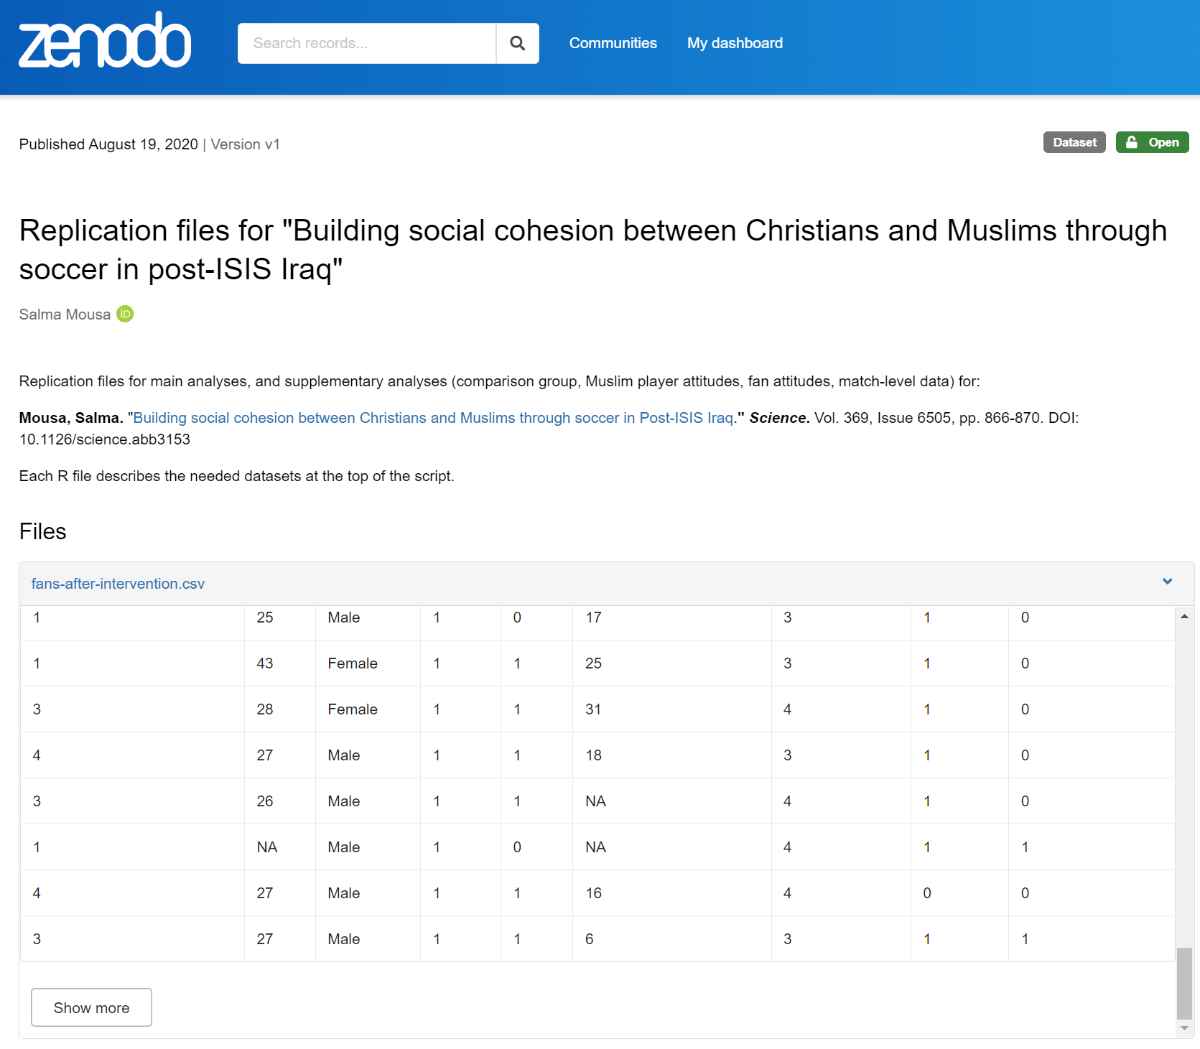
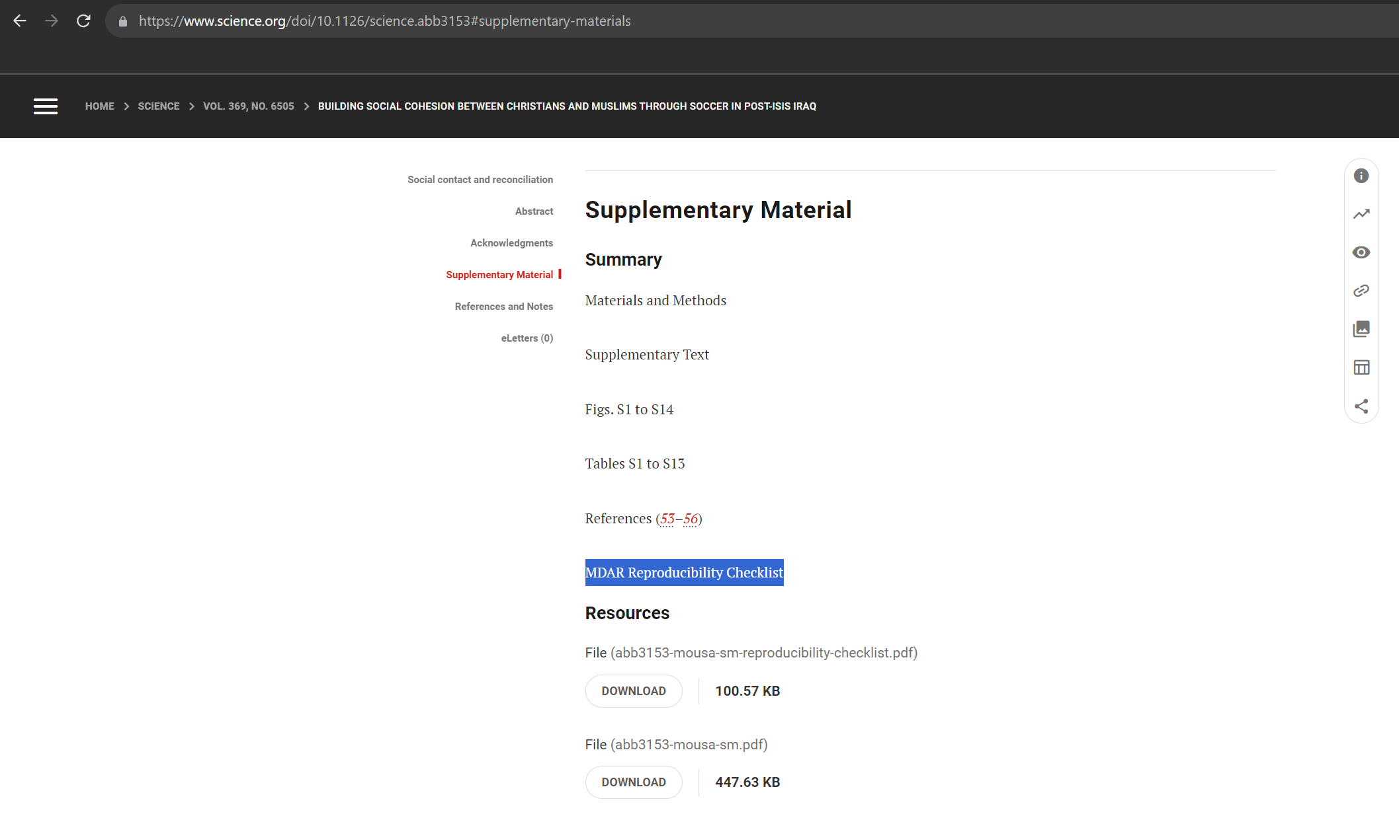
Make sure your study is replicable, accessible
Notes:
https://www.science.org/doi/10.1126/science.abb3153#supplementary-materials
https://zenodo.org/records/3942437

Slide 34
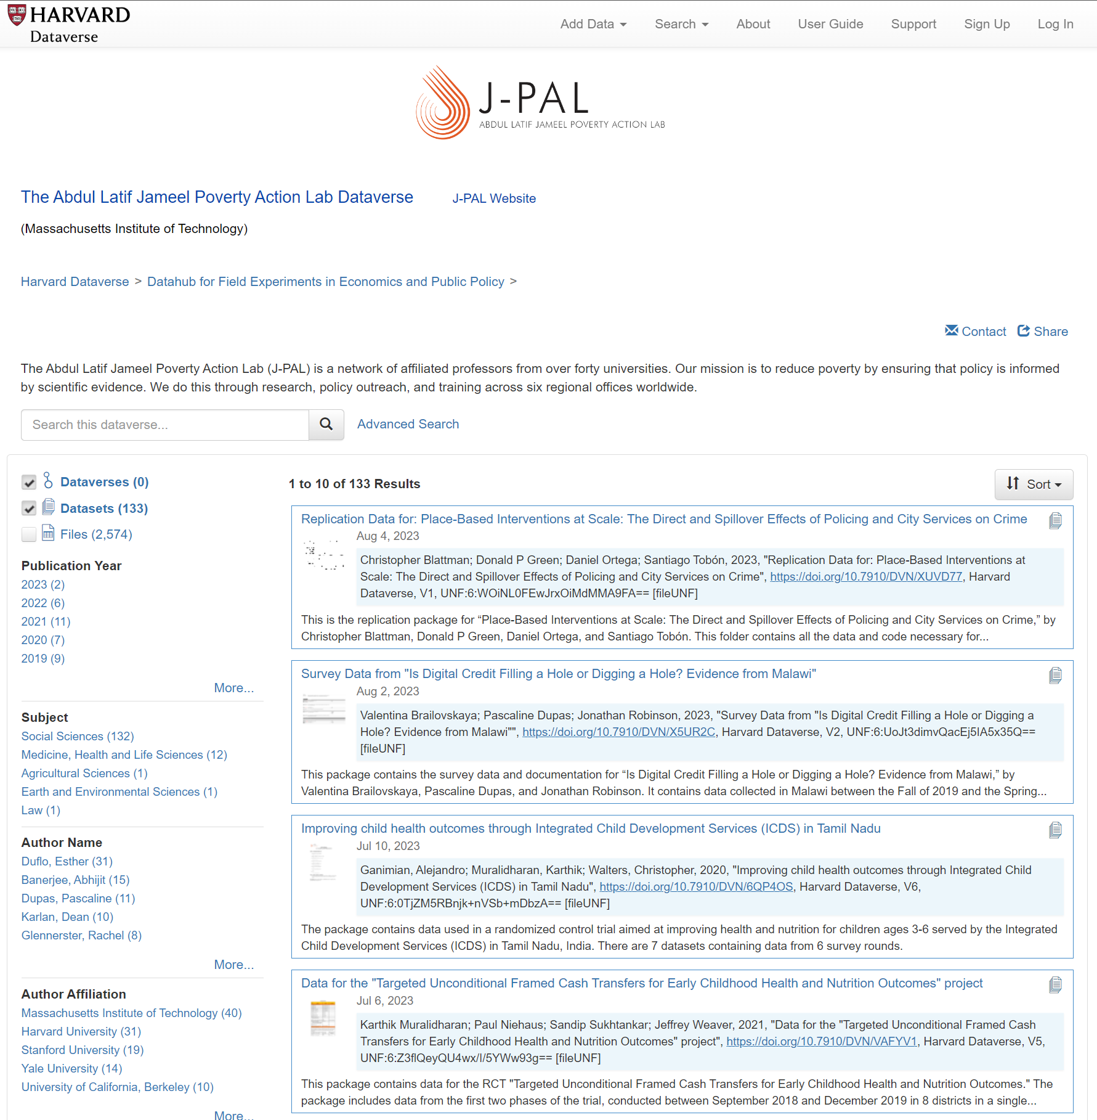
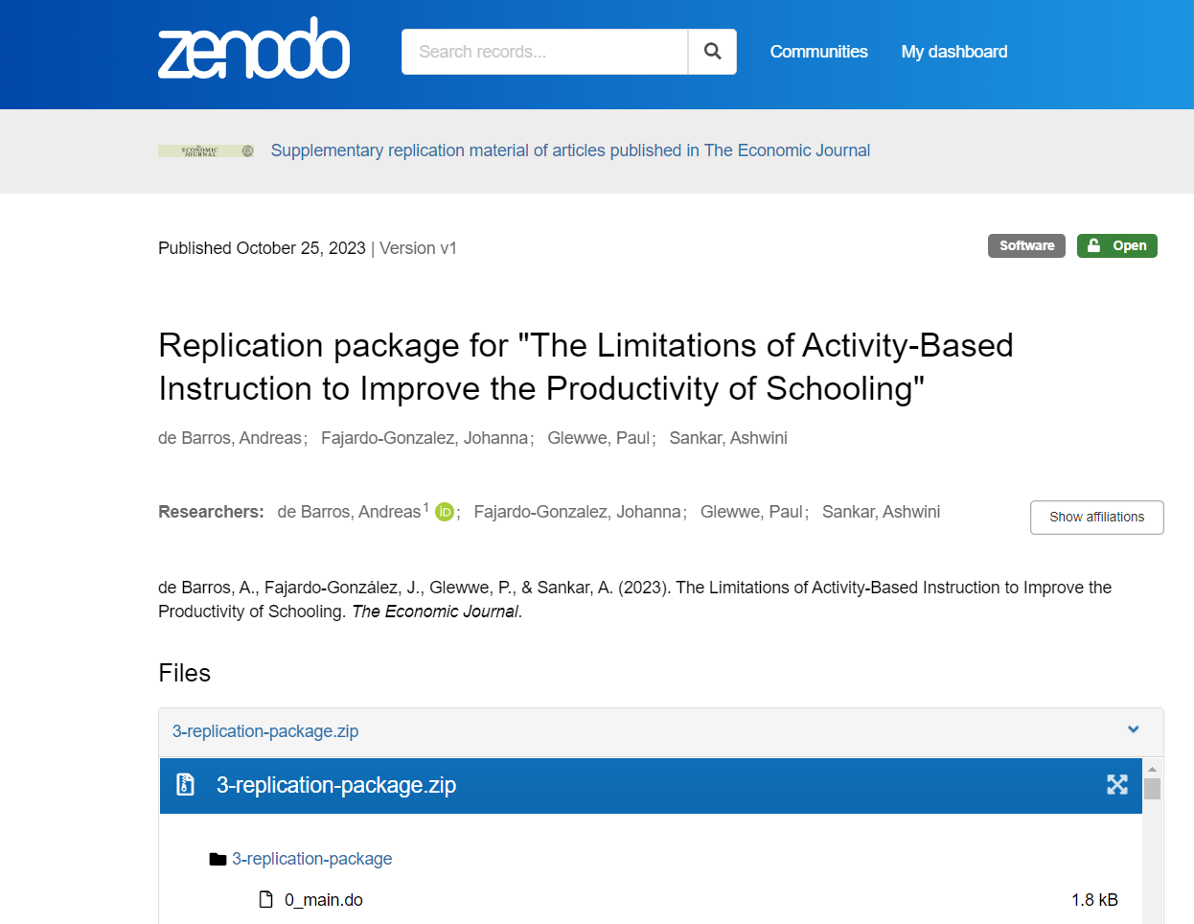
Make use of accessible data, replicate, extend
Notes:
https://zenodo.org/records/10038843

Slide 35
Announcements, plan for next classes
Milestone 3
Due on Sunday
Q&A on Dec 5
Submit questions by Sunday
Message me by Sunday if you can’t attend
EEE Feedback

